Slide 1
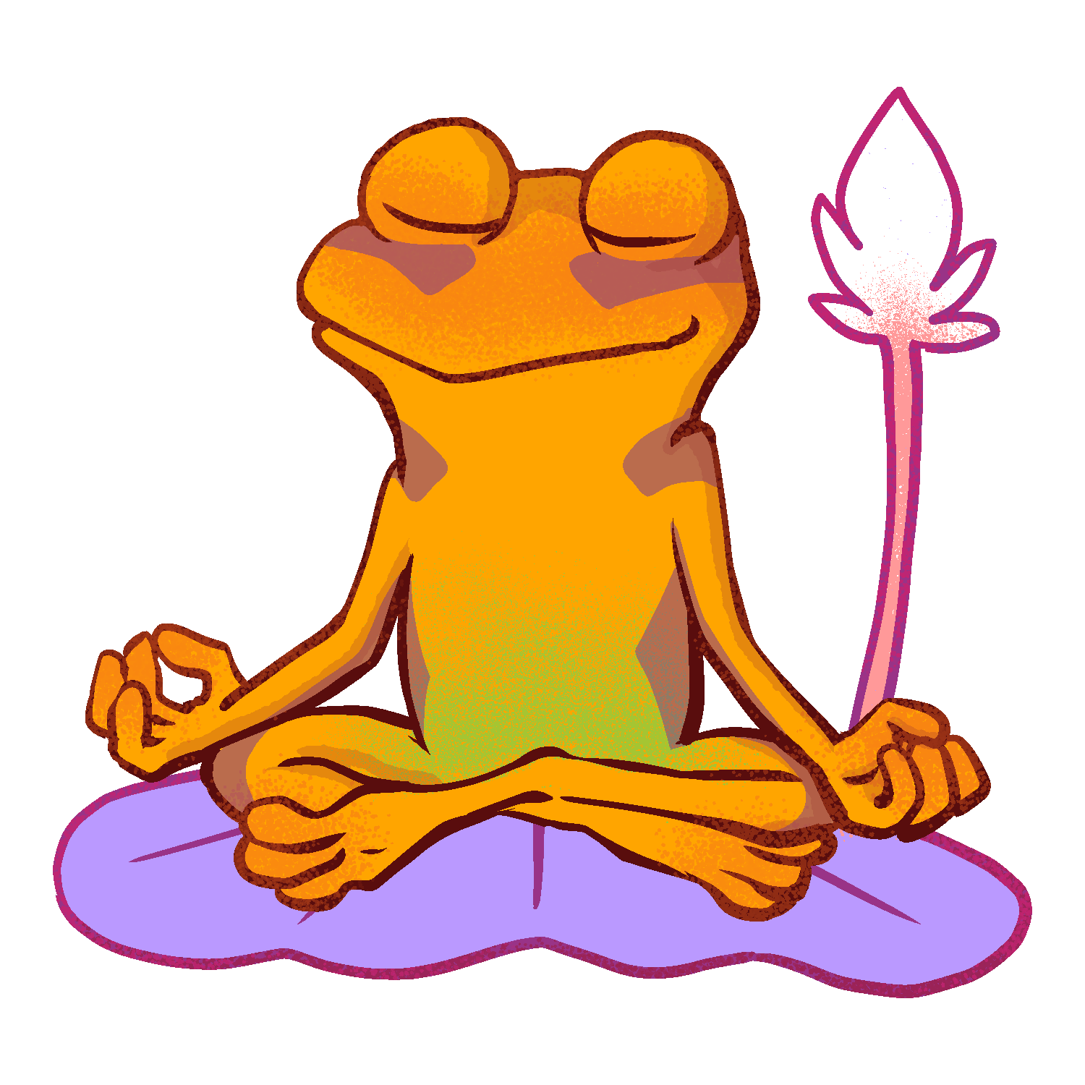
Meditation

Slide 2
Week Two

Slide 3
Learning Objective:
I can use an exercise of listening and breathing to calm and focus my mind
I will use meditation to deal with upsetting situations

Slide 4
Skills
Self Management
Stress Management

Slide 5
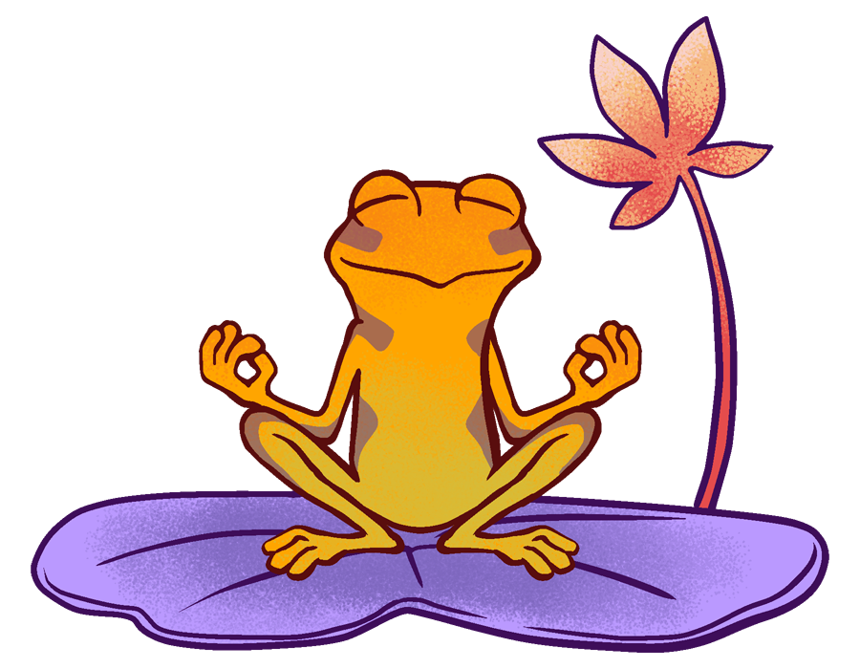
Meditation isn’t all about breathing in an out, you know! Recent studies show that meditating before you study can improve your reading comprehension, memory, concentration, stress and anxiety.

Slide 6
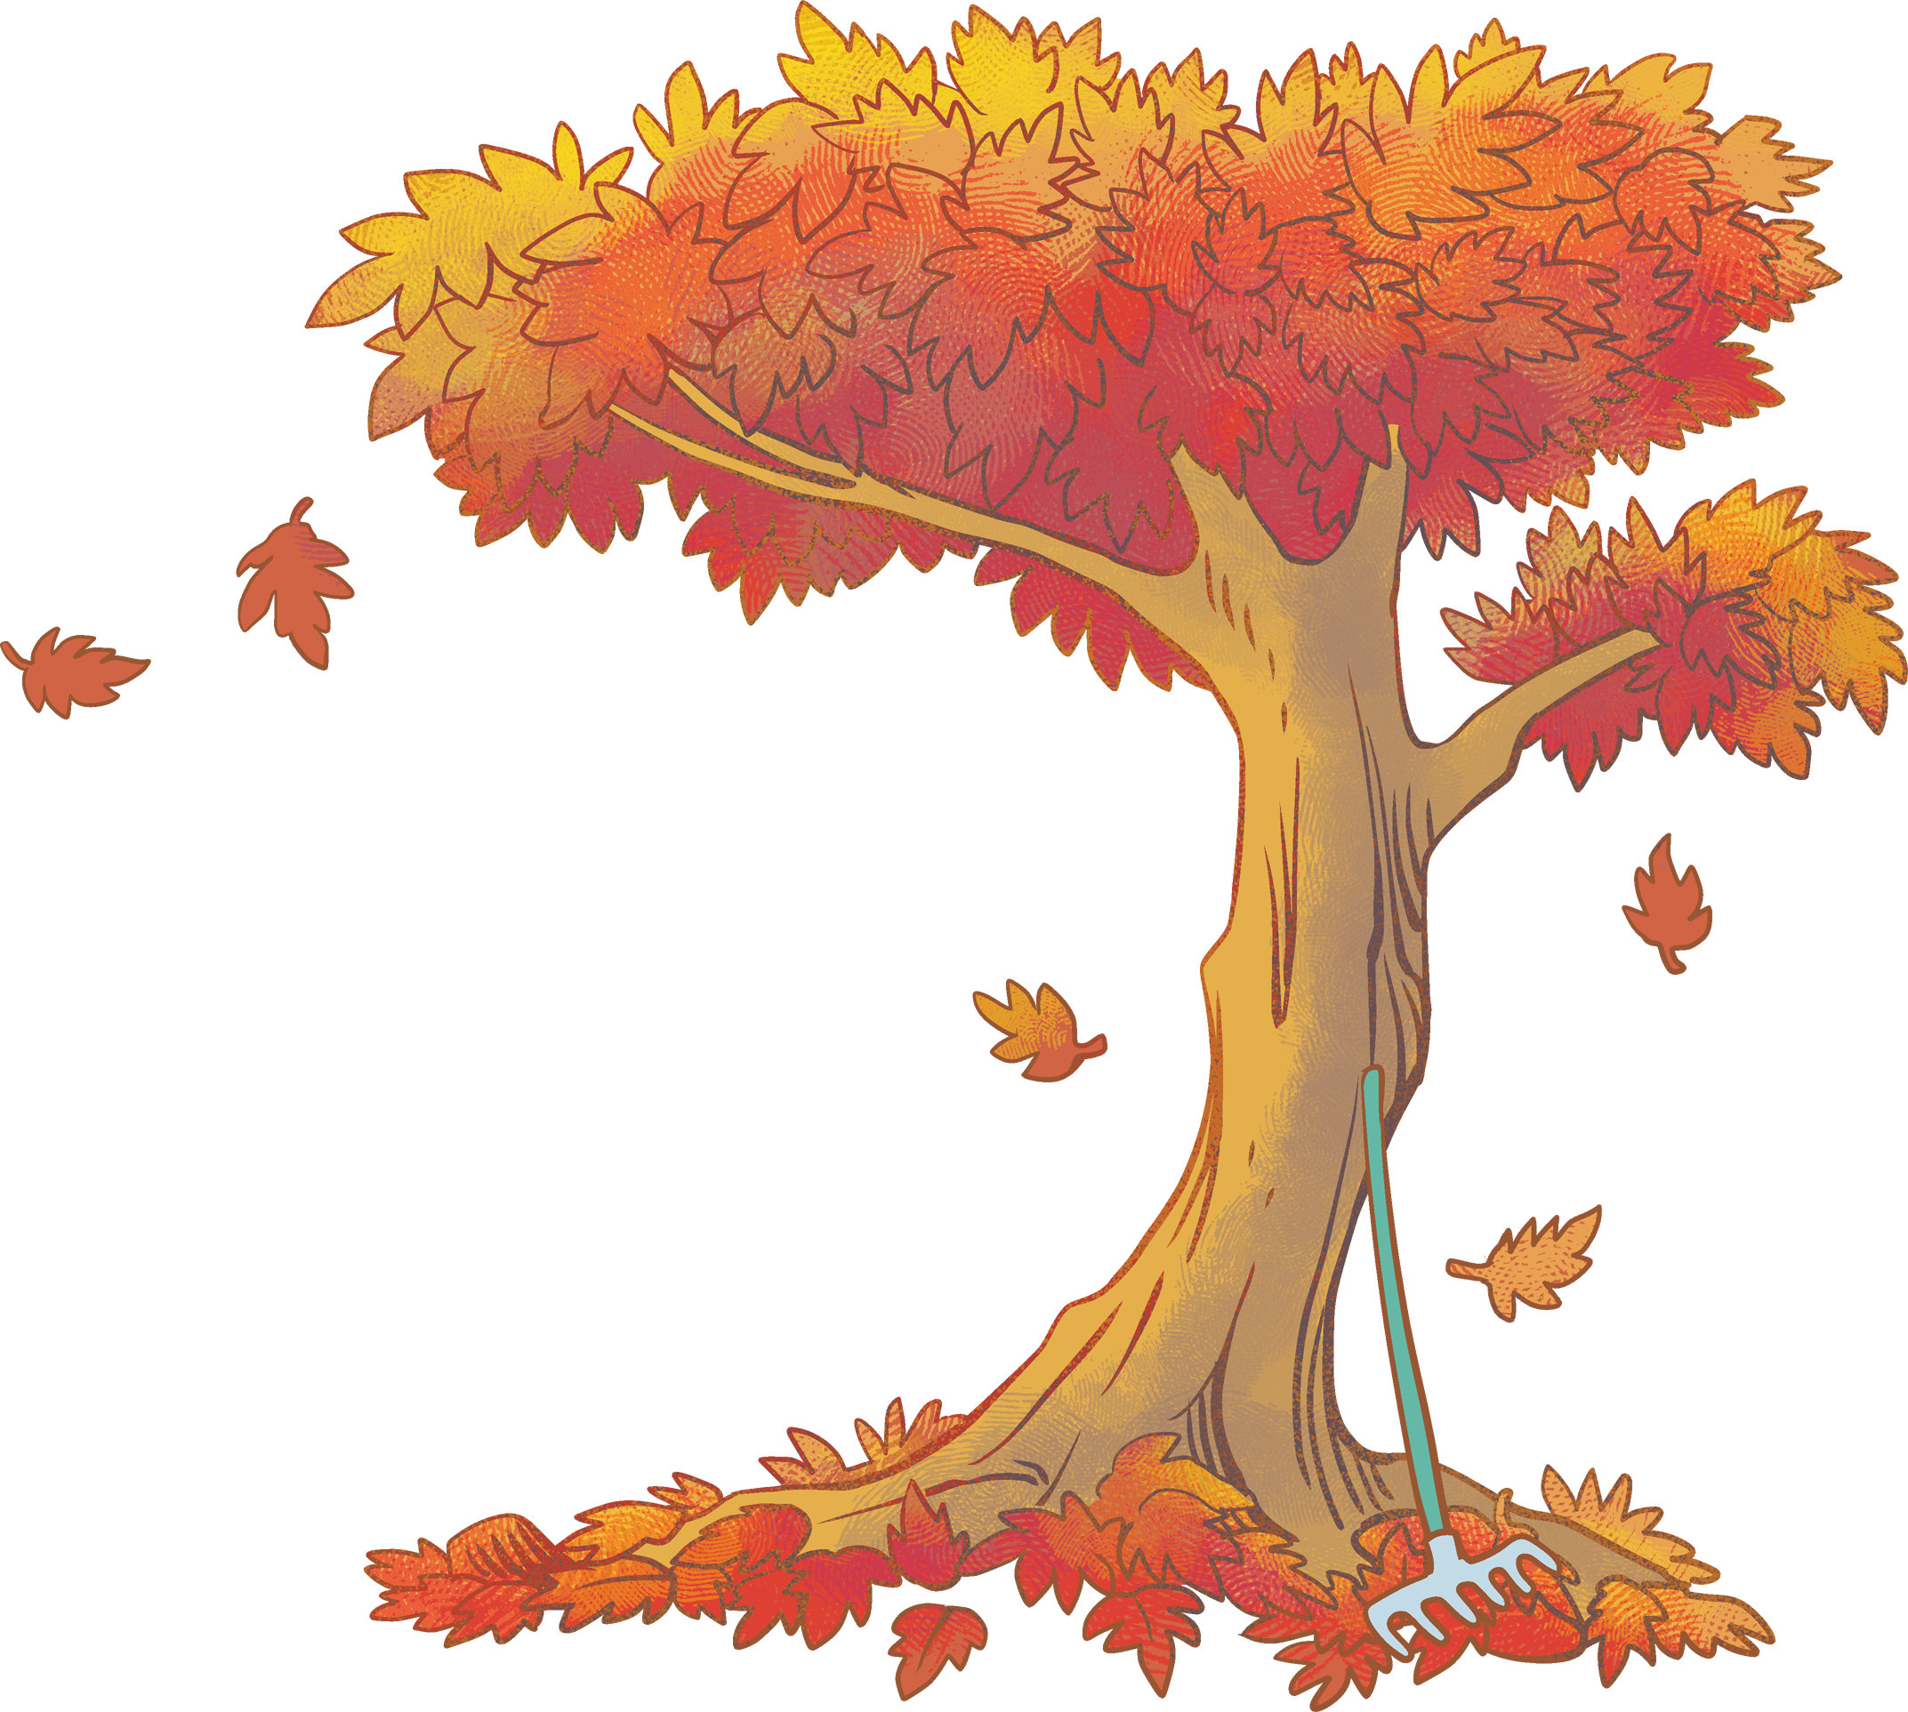
Today, we are going to focus on another type of meditation called
Walking Meditation.
You don’t have to sit still for 30 minutes in order to feel peaceful. Walking meditation will give you a break and allow you to come back to your desk feeling focused and energized. Find a location that is relatively peaceful and where you won’t be disturbed. As you walk, become aware of how the ground feels beneath your feet and concentrate on regulating your breathing. Also become aware of the nature sounds surrounding you that you would usually ignore. The aim is to feel at peace with the world, even if it’s only for a little while.
This meditation will: Boost creativity and productivity.

